Slide 1
Introduction to Programming
Workshop
10 – 11 April 2017
Peter Smyth
UK Data Service

Slide 2
Accessing the course materials
The code snippets used, the file needed for the final exercise, the additional exercises and a copy of the notes are all available on Github at;
https://github.com/pfsmyth/april2017
Download the zip file and extract it to your laptop, somewhere where you can access it easily

Slide 3
Overview of this workshop
This is what we will cover:
Day 1
What is a computer program?
Defining the problem in words and pictures
Documentation
Python programming constructs
More Python
Introduction to testing and debugging
Processing data from files
Notes:
Leave this for Peter

Slide 4
Overview of this workshop
This is what we will cover:
Day 2
Creating functions and using parameters
Introduction to Object Oriented Programming
Introduction to the Pandas package
Introduction to the Matplotlib package
Creating and running complete programs
Notes:
Leave this for Peter

Slide 5
Lesson 8 – Functions & Parameters
All programming language allow developers to create their own functions or procedures. These are sections of code which are written separately from the main program code
Possibly in the same file as the main program.
Used to avoid repetition
Makes the code easier to read.
Functions returns a value, Procedures do not

Slide 6
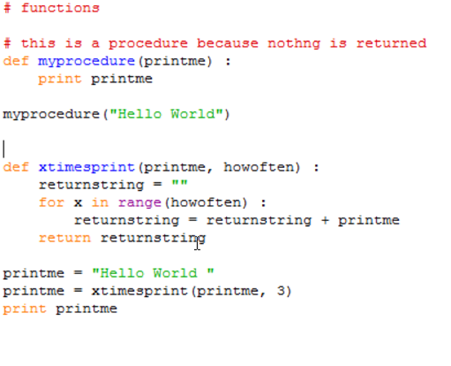
Lesson 8 – functions.py

Slide 7
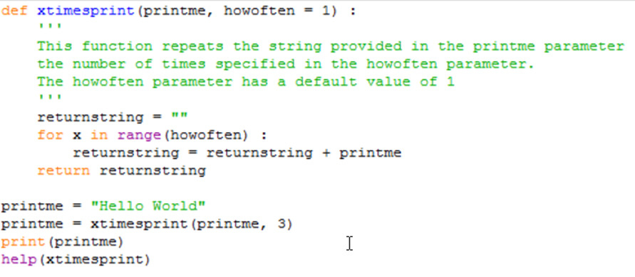
Lesson 8 – functions.py

Slide 8
Lesson 8 – main program parameters
If you want to run your program directly from the command line and don’t want to be prompting the user for input, you can provide values for variables directly on the commandline when you run the program.
You provide the parameters immediately after the program name separating the parameters with a space.
>commandlineargs.py "abc" "def"

Slide 9
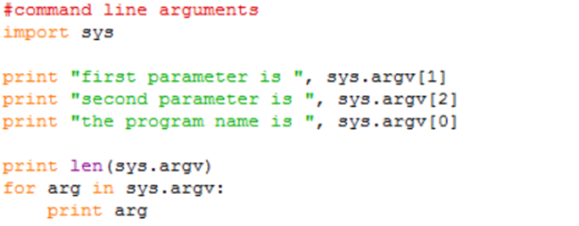
Lesson 8 – commandlineargs.py

Slide 10
Lesson 9 - OOP
Object Oriented Programming (OOP)
Most modern programming languages are built this way
Everything is an object
my_str = “Hello World”
you think of my_str as a string variable
it is in fact an object
Most of the time you don’t care
But it does effect how you call string functions

Slide 11
Lesson 9 - OOP
But what is meant by an object and other key terms?
Key terms
Object
Anything can be one
Encapsulation
Combining data items and the functions (methods) that operate on them into a single unit – an object
Polymorphism
The ability of something to behave differently depending on what it is acting on – in our case, a method with a common name behaves differently depending on the object type it is associated with
Inheritance
Class
Instantiation

Slide 12
Lesson 9 - OOP
But what is meant by an object and other key terms?
Key terms
Inheritance
One class based on another, inherits all of the data variables and methods of the parent class
Class
A template or bluebrint for creating an object
Instantiation
A specific object which is created based on some class

Slide 13
Lesson 9 - OOP
Example – Office Documents

Slide 14
Lesson 10 – Pandas & Matplotlib
Pandas - used for data manipulation and simple analysis
Probably the most used Python package
Matplotlib - used for data visualisation
Also heavily used, but has more competition

Slide 15
Lesson 10 – Pandas
Can be installed with the pip command
Already installed with the Anaconda installation
The full documentation is available for download at
http://pandas.pydata.org/
The pdf file has over 1900 pages in it
‘Cheatsheets’ are available
https://github.com/pandas-dev/pandas/blob/master/doc/cheatsheet/Pandas_Cheat_Sheet.pdf

Slide 16
Lesson 10 – Pandas
Pandas can be used to read csv files
Also JSON files and HTML pages from the web
The difference between using pandas and just using core Python commands as we did earlier is very important
Using the core commands we read the file one line at a time.
Using Pandas, you read all of the file at once
Pandas creates a representation of the whole file, which it calls a DataFrame, which you can treat as a table.
Rows and Columns

Slide 17
Lesson 10 – Pandas
We will only look at a tiny part of it.
Reading csv files
Select specific columns
Select specific rows
Provide simple summary statistics on numeric columns
Aggregation across columns
Creating new columns
Simple plotting of data

Slide 18
Lesson 10 – Pandas demonstration

Slide 19
Lesson 10 – Matplotlib
Can be installed with the pip command
Already installed with the Anaconda installation
The full documentation is available for download at
http://matplotlib.org/
The pdf file has approx. 3000 pages in it
‘Cheatsheets’ are available
https://s3.amazonaws.com/assets.datacamp.com/blog_assets/Python_Matplotlib_Cheat_Sheet.pdf
The plotting capabilities are far more extensive than available in Pandas

Slide 20
Lesson 10 – Matplotlib
Matplotlib provides far more sophisticated plotting capabilities than Pandas
We will only look at pyplot – this provides a MATLAB type plotting environment
Doesn’t matter if you haven’t used MATLAB, really just to show that like Pandas, there is an awful lot in Matplotlib.

Slide 21
Lesson 10 – Matplotlib
Types of graphs
Line graphs
Scatterplots
Box & Whisker plots
Apart from the actual data, you can
Add axis labels
Set axis ranges
Add titles
Add text
Add legends

Slide 22
Lesson 10 – Matplotlib demonstration

Slide 23
Lesson 11
Your Turn!
(programming tasks.docx)

Slide 24
Peter Smyth
Peter.smyth@manchester.ac.uk
ukdataservice.ac.uk/help/
Subscribe to the UK Data Service news list at https://www.jiscmail.ac.uk/cgi-bin/webadmin?A0=UKDATASERVICE
Follow us on Twitter https://twitter.com/UKDataService
or Facebook https://www.facebook.com/UKDataService

